Slide 1
Discrete Random variable
Expected value of a random variable

Slide 2
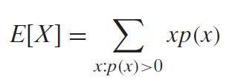
EXPECTED VALUE OF A DISCRETE RANDOM VARIABLE
If X is a discrete random variable having probability mass function p(x) then its expected value is
It is nothing but weighted mean/average of X

Slide 3
Example
Fair Coin Toss.
X is the outcome when you toss a fair coin
X[H]=1
X[T]=0
Find E[x]

Slide 4
Example
The random variable X, is the outcome when you roll a die
Find E[X]

Slide 5
What is the expected value of the square of the number you rolled on a die?
What is the expected value of the cube of each of the number the random variable X can take.
When X is the outcome when you roll a die

Slide 6
Similarly we have expected value for any function of random variable
E[2X]=
E[2X-1]=
E[(X-5)^2]=

Slide 7
IMPORTANT RESULT
If X is a random variable and g(x) is a function of that random variable then
E[g(x)]=∑g(x)p(X=x)

Slide 8
Linearity of expected value of X
E[aX+b]=aE[X]+b
Important Note:
E[b]=?
Is E[X^2]= (E[X])^2? When does it hold?

Slide 9
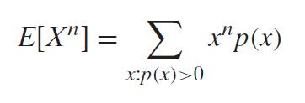
MOMENT
E[X] is called the first moment of X
E[X^{n}] is called the n^{th} moment of X

Slide 10
Variance of Random Variable X

Slide 11
Variance of the random variable X
A measure how much spread is the random variable
If X is a random variable with
mean µ ( Expected value),then the variance of
X, denoted by Var(X) is defined by
Alternate formula : Var(X)= E[X^2]-(E[x])^2

Slide 12
Linearity of Variance of X
Var(aX+b)=?
Does Linearity hold here?
Var[b]=?
Var[X+b]=?

Slide 13
Example
Calculate Var(X) if X represents the outcome when a fair die is rolled.

Slide 14
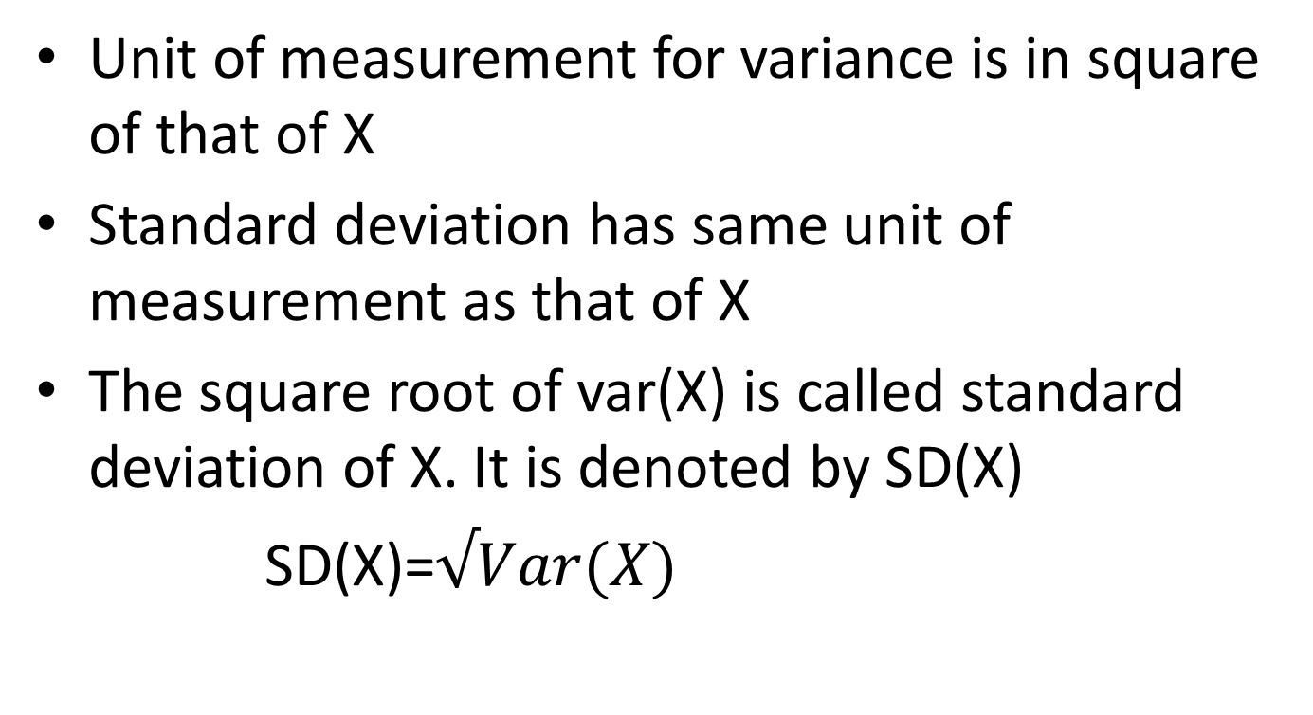
Standard deviation of X
Unit of measurement for variance is in square of that of X
Standard deviation has same unit of measurement as that of X
The square root of var(X) is called standard deviation of X. It is denoted by SD(X)
SD(X)=$√Var(X)$

Slide 15
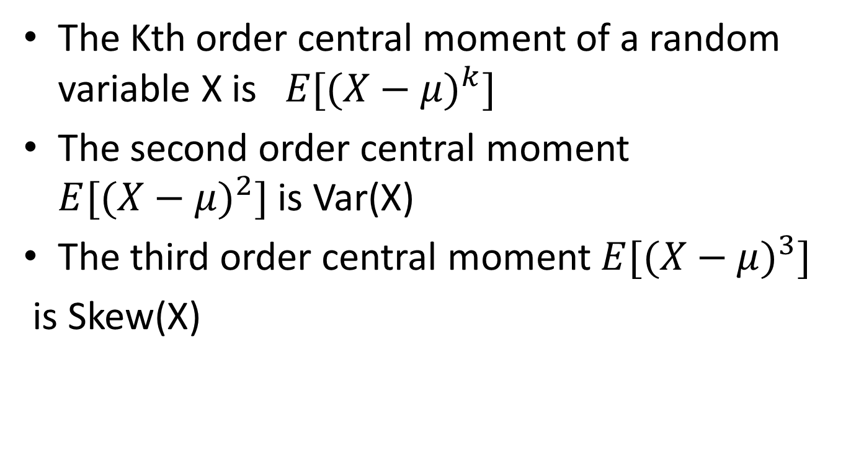
Central Moment( Moments about mean)
The Kth order central moment of a random variable X is$E[({X−μ)}^{k}]$
The second order central moment $E[({X−μ)}^{2}]$ is Var(X)
The third order central moment $E[({X−μ)}^{3}]$
is Skew(X)

Slide 16
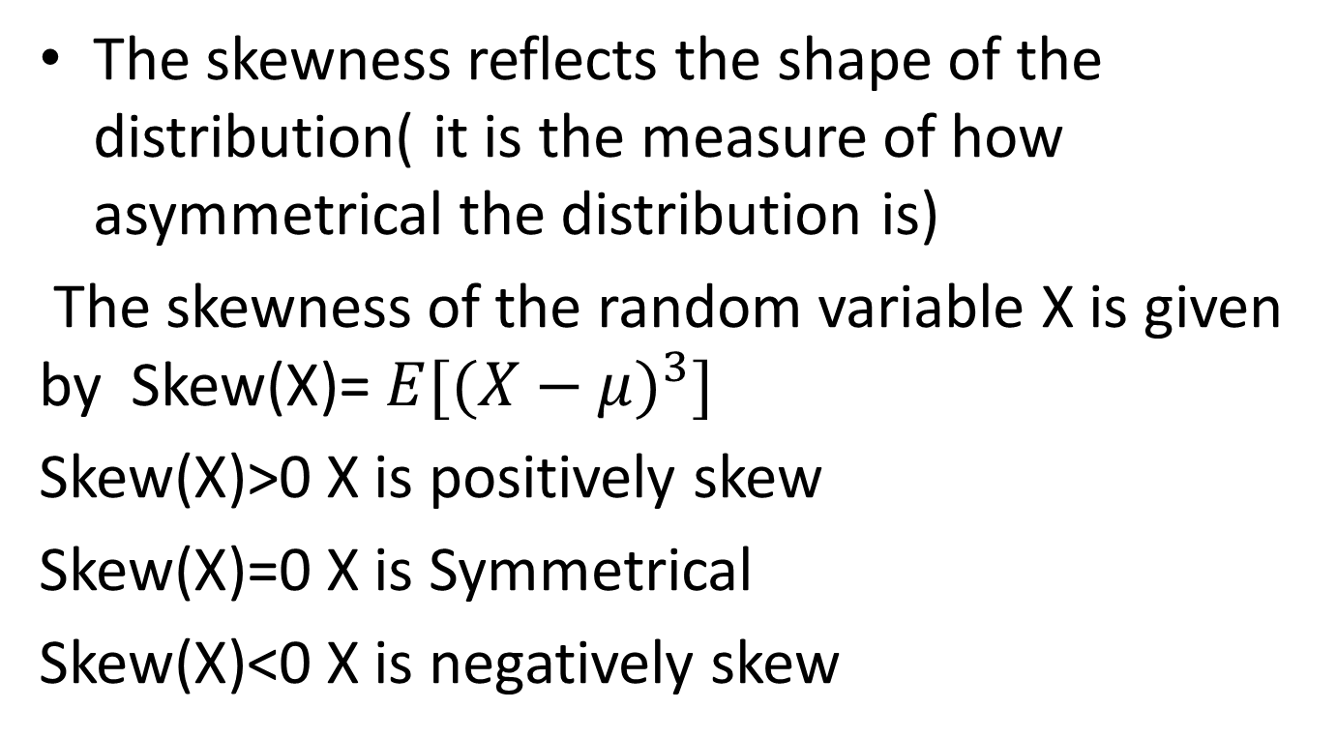
Skewness of random variable X
The skewness reflects the shape of the distribution( it is the measure of how asymmetrical the distribution is)
The skewness of the random variable X is given by Skew(X)= $E[({X−μ)}^{3}]$
Skew(X)>0 X is positively skew
Skew(X)=0 X is Symmetrical
Skew(X)<0 X is negatively skew

Slide 17
Discrete Distributions

Slide 18
Important Discrete Distributions
Uniform Distribution
Bernoulli Distribution
Binomial Distribution
Poisson’s Distribution

Slide 19
Discrete Uniform Distribution
Sample space S={1,2,3…k}
If all outcomes are equally likely then the random X is defined as
X=x where (x=1,2,…k)
P(X=x)=1/k
Properties:
Expected value=?
Variance=?

Slide 20

For Discrete uniform distribution
P(X=x)=1/k
E[X]=(k+1)/2
Var[X]=$\frac{{(K}^{2}−1)}{12}$

Slide 21
A Bernoulli trial is an experiment which has only two possible outcomes
– Success
– Failure
Bernoulli r.v.
– X(Success) = 1
– X(Failure) = 0
Bernoulli Distribution
•
•
•
•
PMF of Bernoulli
E[X] = ?
Var[x]=?
r.v.
:
p(0)=1-p;
p(1) = p

Slide 22

For Bernoulli Distribution
P(X=x)=$p^{x}{(1−p)}^{1−x}$
E[X]=p
Var[X]=p(1-p)

Slide 23
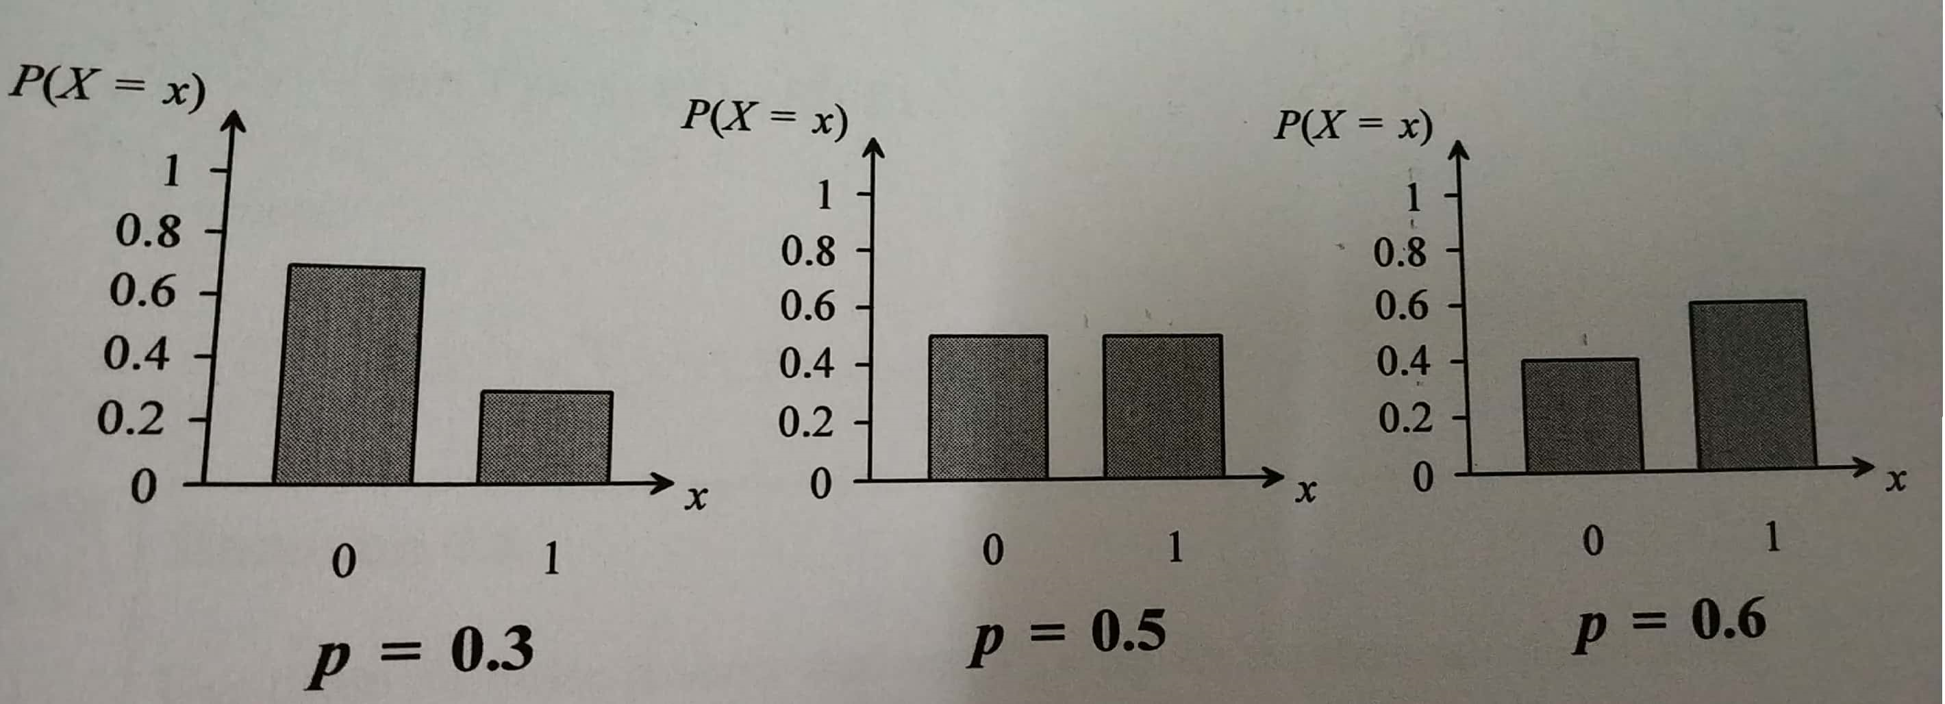
Bernoulli distributions with different values of p

Slide 24
Binormial r.v.
independent Bernoulli trials are performed
is the probability of success of each trial
= number of successes, called binomial r.v.
•
•
•
•
•
n
p
X
(n,p) is called the parameter of X.
X with its parameter set to (1,p) is ?

Slide 25

PMF of binomial random variable
Random variable X is the number of successes that occur in n Bernoulli trials.
P(X=x)=${}_{}^{n}{Cx}p^{x}{(1−p)}^{1−x}$

Slide 26
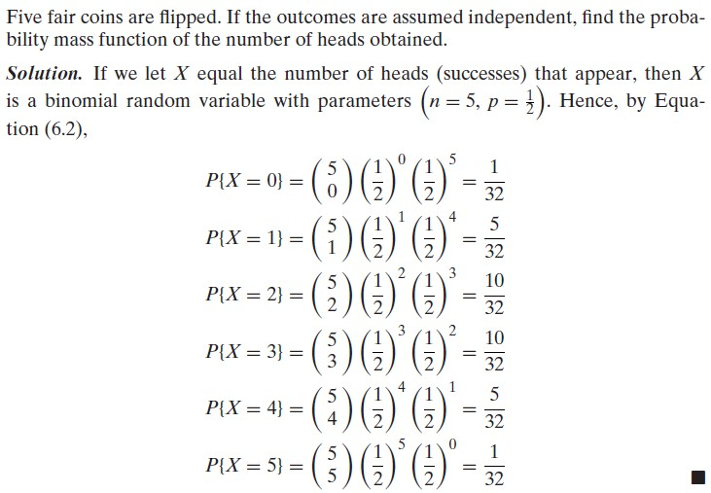
Example:

Slide 27
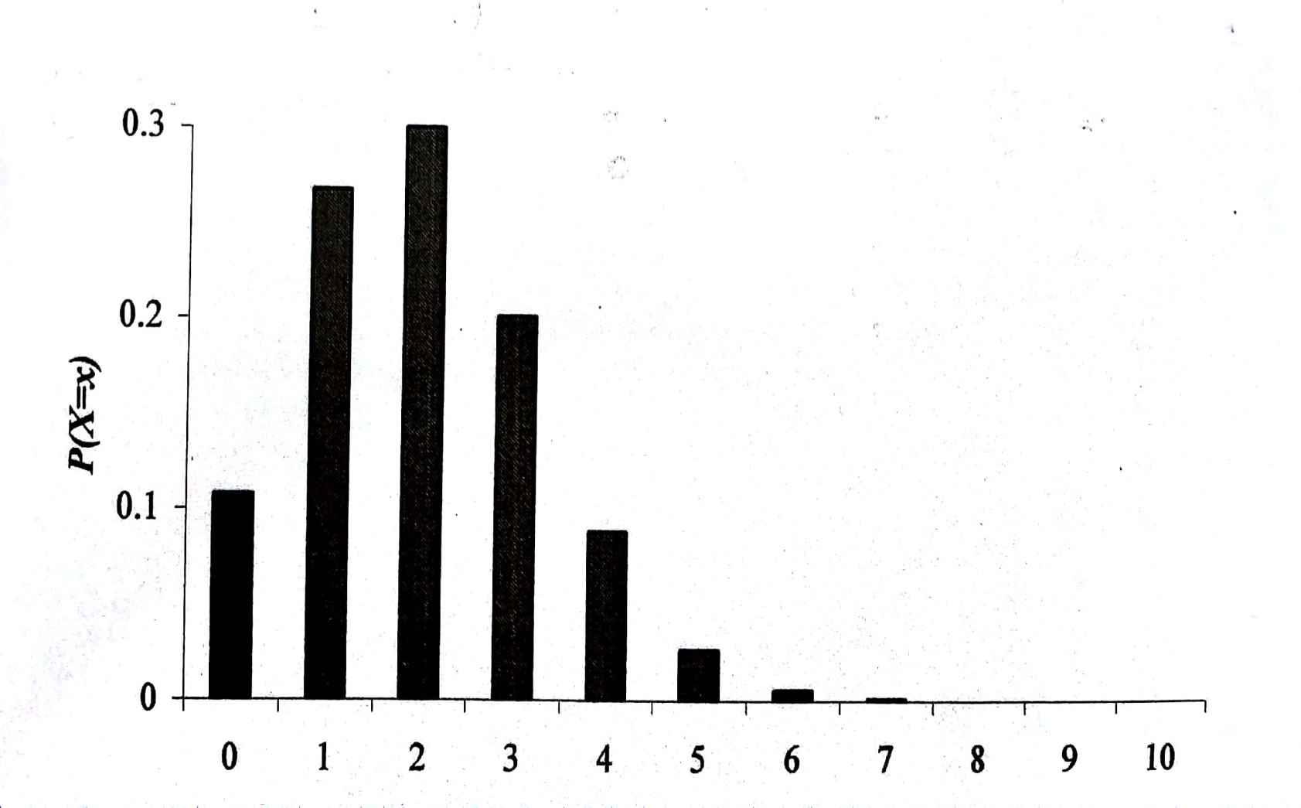
Figure shows 10 trials with probability of success of 0.2

Slide 28
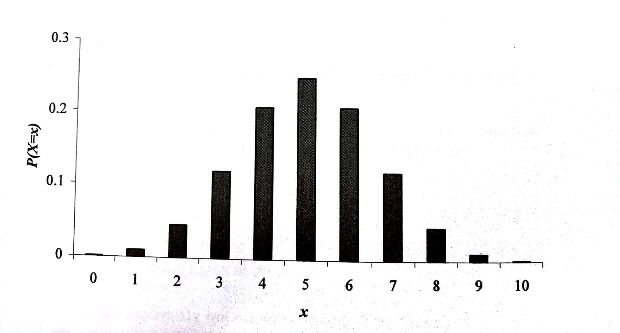
Figure shows 10 trials with probability of success of 0.5

Slide 29
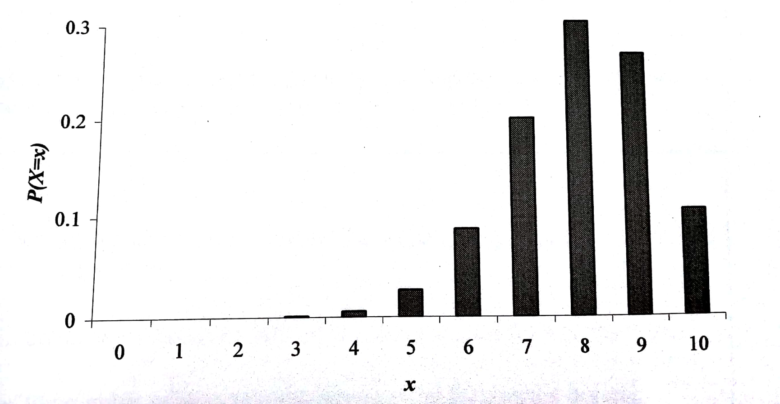
Figure shows 10 trials with probability of success of 0.8

Slide 30
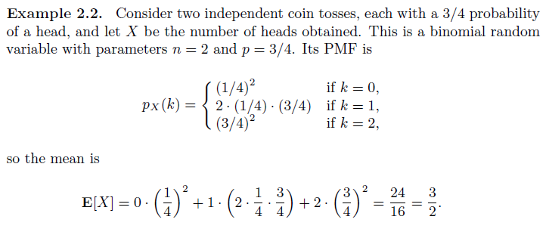
Expected Value of a binomial r.v.

Slide 31
E[binomial r.v.]
Let X be the binomail r.v. with parameter (n, p)
Let X_{i} be the corresponding Bernoulli
X = X₁ +………+ X _{n}
E[ X ] = E[ X₁ ] +...+ E[ X _{n} ] = p +….+
r.v.(with same p )
p = n ⋅ p

Slide 32
Var(X)
Let X be the binomail r.v. with parameter (n, p)
Let X_{i} be the corresponding Bernoulli r.v. (with same p )
X = X₁ +…..+ X _{n}
Var( X ) = Var( X₁ ) +…+Var( X _{n} ) = p(1− p) +….+ p(1− p)
= n ⋅ p(1− p)

Slide 33

For Binomial random variable X
P(X=x)=${}_{}^{n}{Cx}p^{x}{(1−p)}^{1−x}$
E[X]=np
Var[X]=np(1-p)

Slide 34

Poisson Distribution
A random variable X that takes the values 0,1,2…. is said to be a Poisson random variable with parameter λ for some λ>0

Slide 35
Where is it useful?
This distribution models the number of events that occur in a specified interval of time(For modeling the events that occur at a rate of λ per unit of time or length.
The poisson distribution is exceptionally useful in general insurance for modeling the number of claims received by an insurance office.

Slide 36
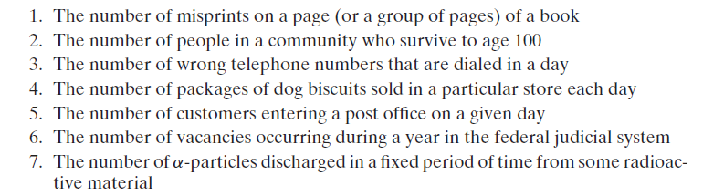
Examples:

Slide 37

Another Approach
The limiting case of Binomial random variable is Poisson random variable.
That is n $→$ ∞ and p $→$0 we get np $→λ$
Proof:

Slide 38
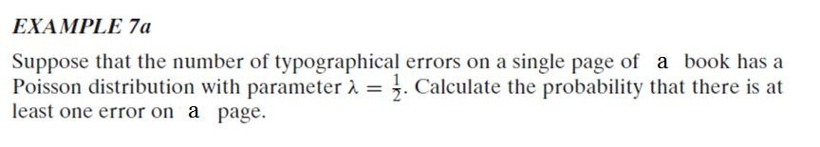

Slide 39
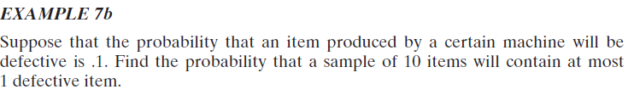

Slide 40
Expected value and variance of the poisson random variable
E[X]=?
Var[X]=?

Slide 41

For Poisson random variable X
P(X=x)=$e^{−λ}\frac{λ^{x}}{x!}$ where x=0,1,2…..
E[X]=λ
Var[X]=λ

Slide 42
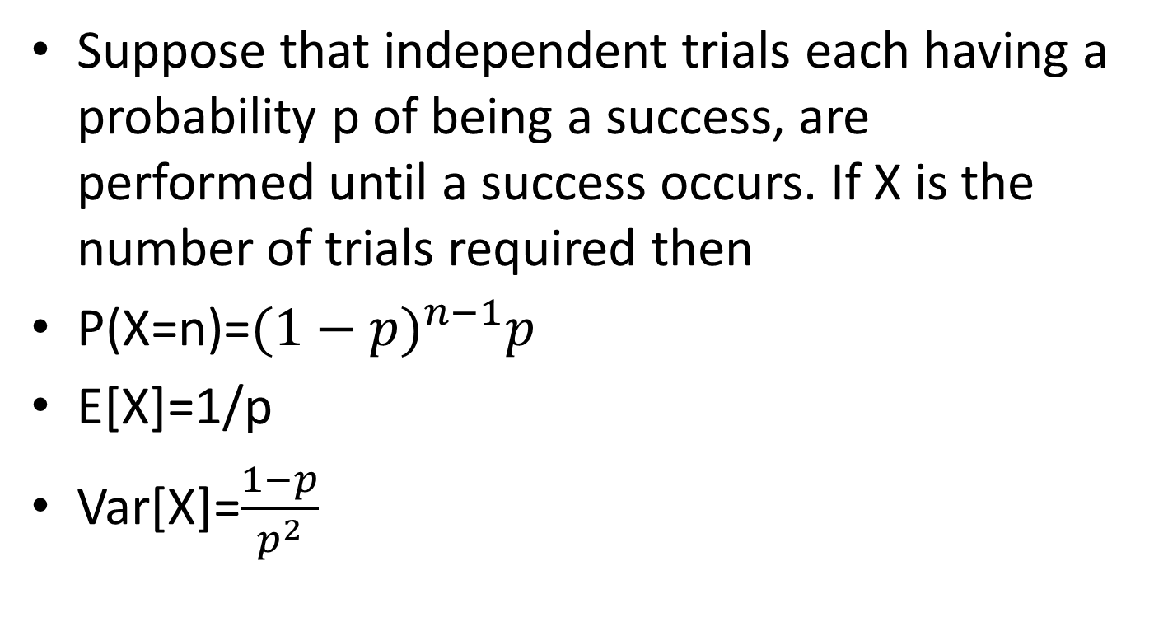
Geometric random variable
Suppose that independent trials each having a probability p of being a success, are performed until a success occurs. If X is the number of trials required then
P(X=n)=${(1−p)}^{n−1}p$
E[X]=1/p
Var[X]=$\frac{1−p}{p^{2}}$

Slide 43
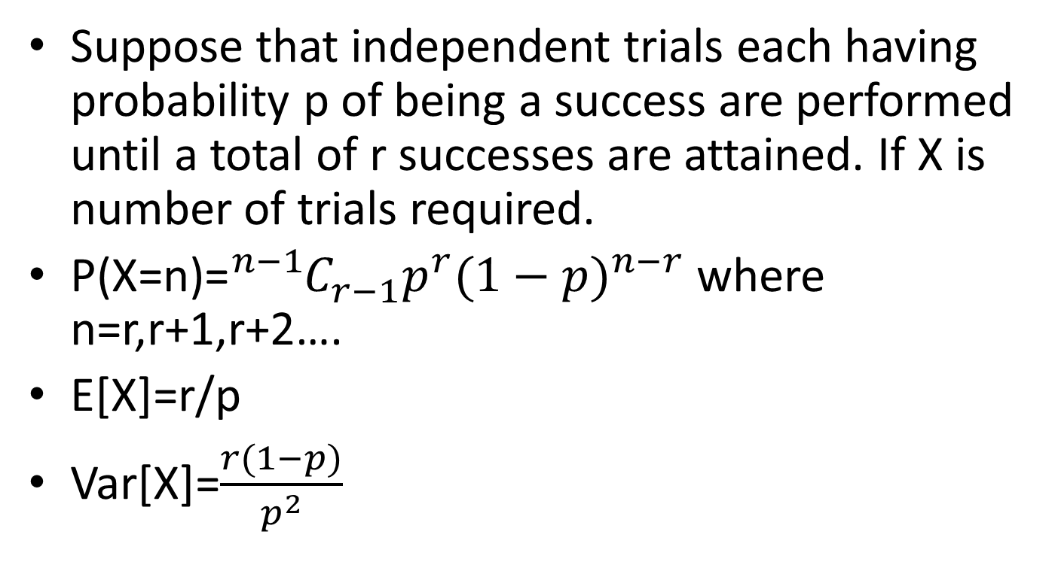
Negative Binomial random variable
Suppose that independent trials each having probability p of being a success are performed until a total of r successes are attained. If X is number of trials required.
P(X=n)=${{}_{}^{n−1}C}_{r−1}^{}p^{r}{(1−p)}^{n−r}$ where n=r,r+1,r+2….
E[X]=r/p
Var[X]=$\frac{r(1−p)}{p^{2}}$

Slide 44
Examples
If the probability of having a girl or boy child is equal. What is the probability that a women’s fourth child is a first girl?
If the probability that a person will believe a rumor about a scandal in politics is 0.8.find the probability that the 9th person to hear the rumor will be the 4th person to believe it

